Slide 1
Héroïque !
And I think to myself
« What a wonderful world ! »

Slide 2
https://www.flickr.com/photos/glaxosmithkline/29157728454/in/album-72157666714575939/

Slide 3
https://www.flickr.com/photos/glaxosmithkline/29702999331/in/album-72157666714575939/

Slide 4
Beatrice Vio
https://www.flickr.com/photos/glaxosmithkline/29672928342

Slide 5
https://www.mercedes-benz.com/en/lifestyle/me-magazine/uncontested-laureus

Slide 8
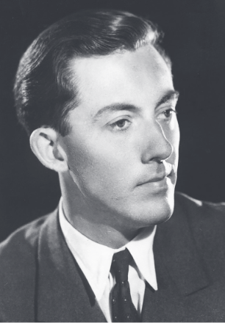
Michael Ventris
https://itsallgreektoanna.files.wordpress.com/2018/01/judson-the-decipherment-2.pdf

Slide 9
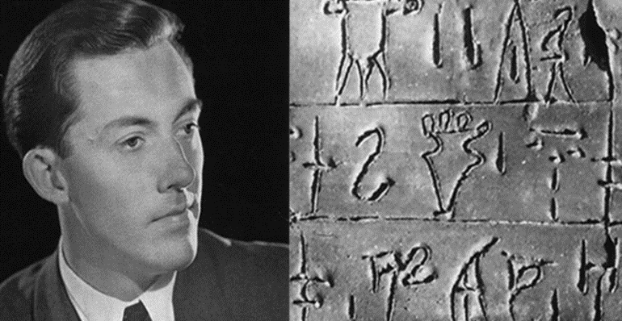

Slide 10
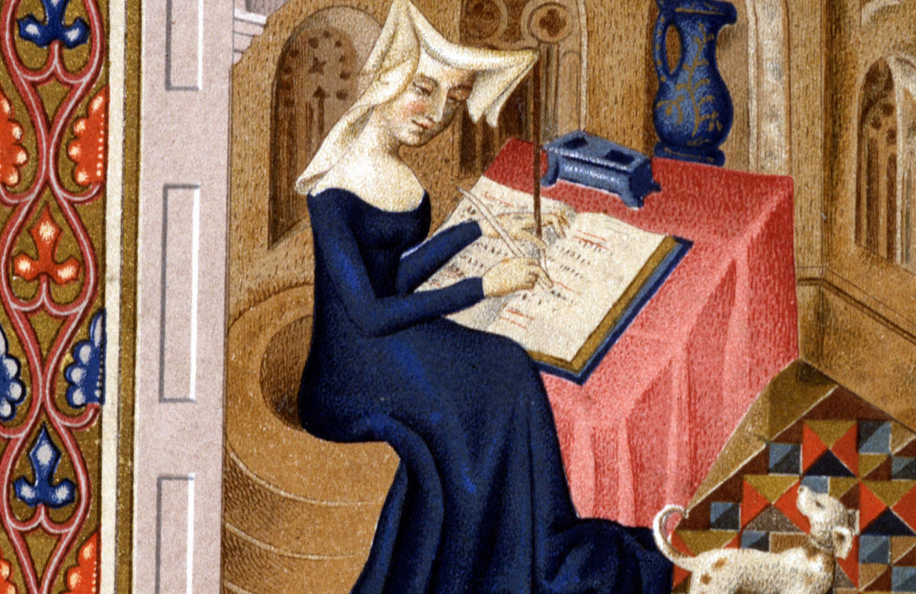
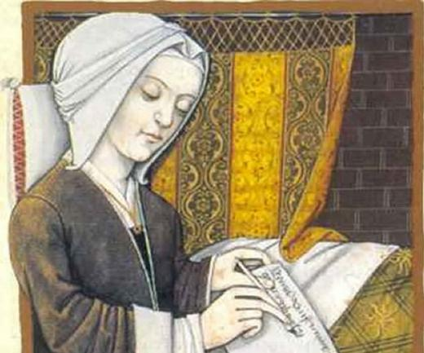
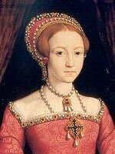
Christine de Pisan
https://www.compagnie-litteraire.com/christine-de-pizan/

Slide 11
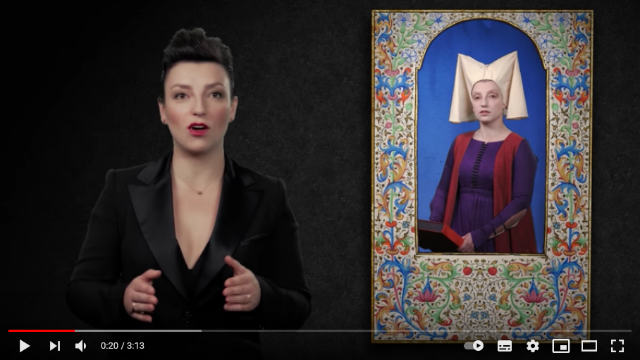
https://www.youtube.com/watch?v=01FvYaBJdBs

Slide 12
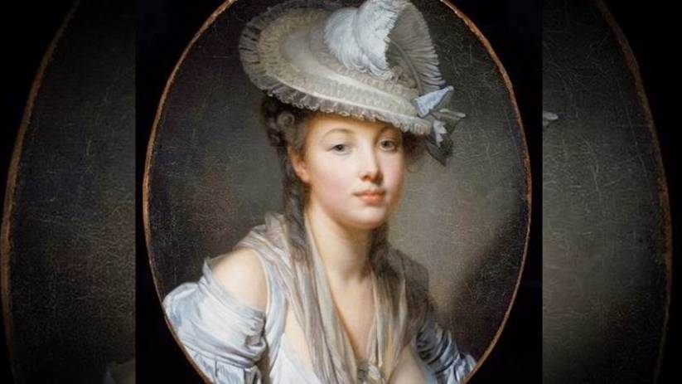
Olympe de Gouges
https://www.youtube.com/watch?v=WvRT3olP-0I

Slide 13
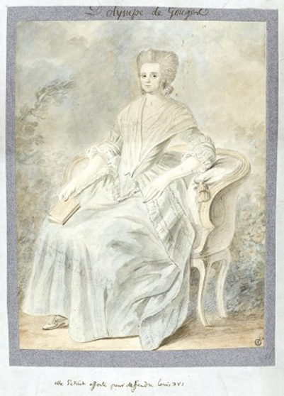
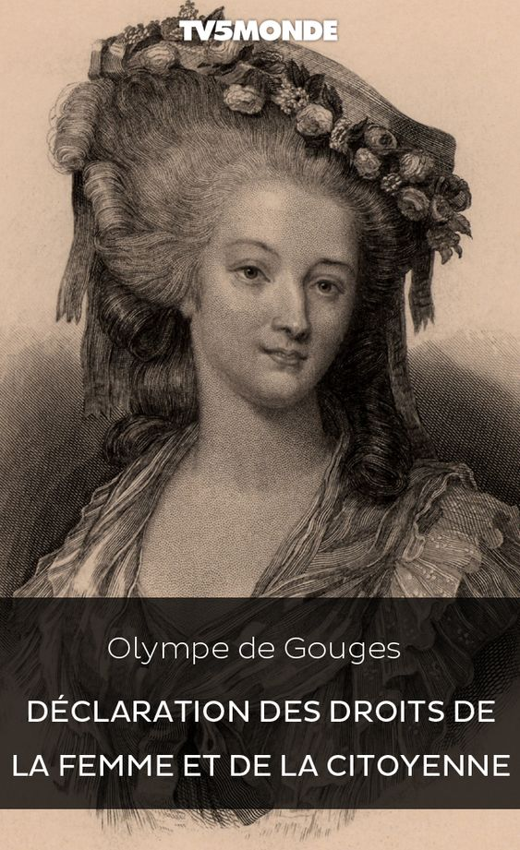

Slide 14
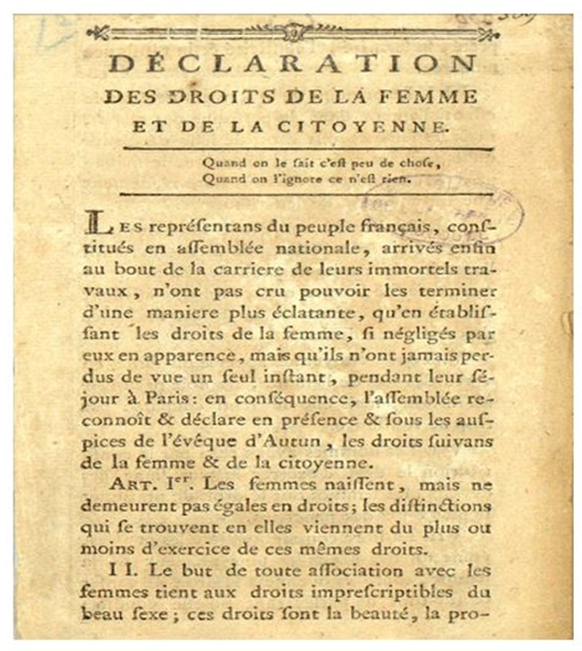

Slide 15
https://www.youtube.com/watch?v=WvRT3olP-0I

Slide 16
Le discours du
Dr. Denis Mukwege,
prix Nobel de la paix
https://www.lemonde.fr/afrique/article/2018/12/12/les-cinq-phrases-a-retenir-du-discours-de-denis-mukwege-prix-nobel-de-la-paix-2018_5396536_3212.html
https://www.youtube.com/watch?v=whsRdYLvMw4

Slide 17
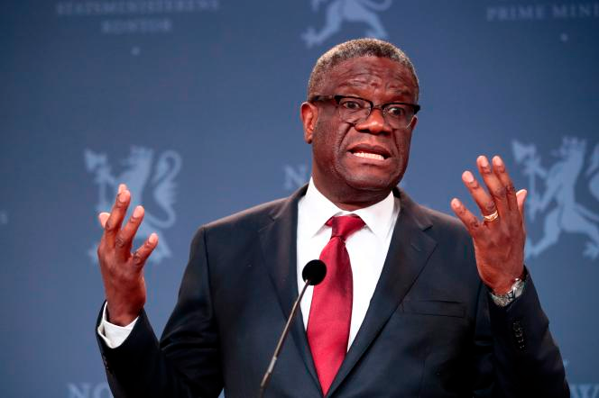
https://www.youtube.com/watch?v=JnW4r0Qf8EM
https://www.youtube.com/watch?v=AAkY1Y6TC30

Slide 18
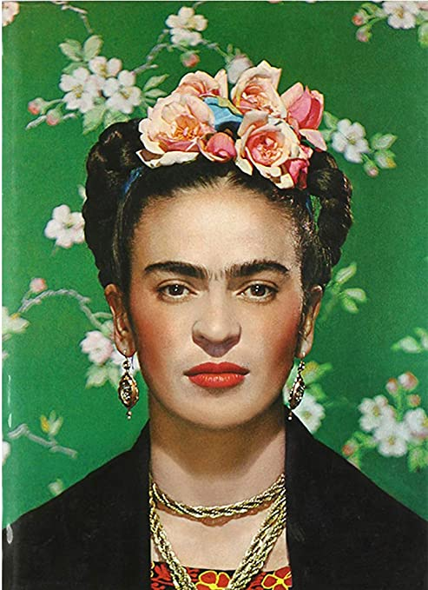
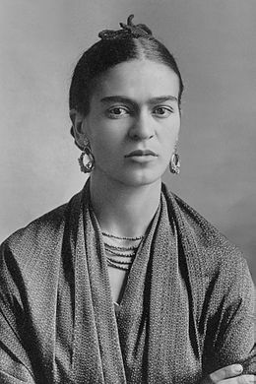
Frida Kahlo
https://www.youtube.com/watch?v=0fMpSmx9Kek

Slide 19
https://www.youtube.com/watch?v=0fMpSmx9Kek

Slide 20
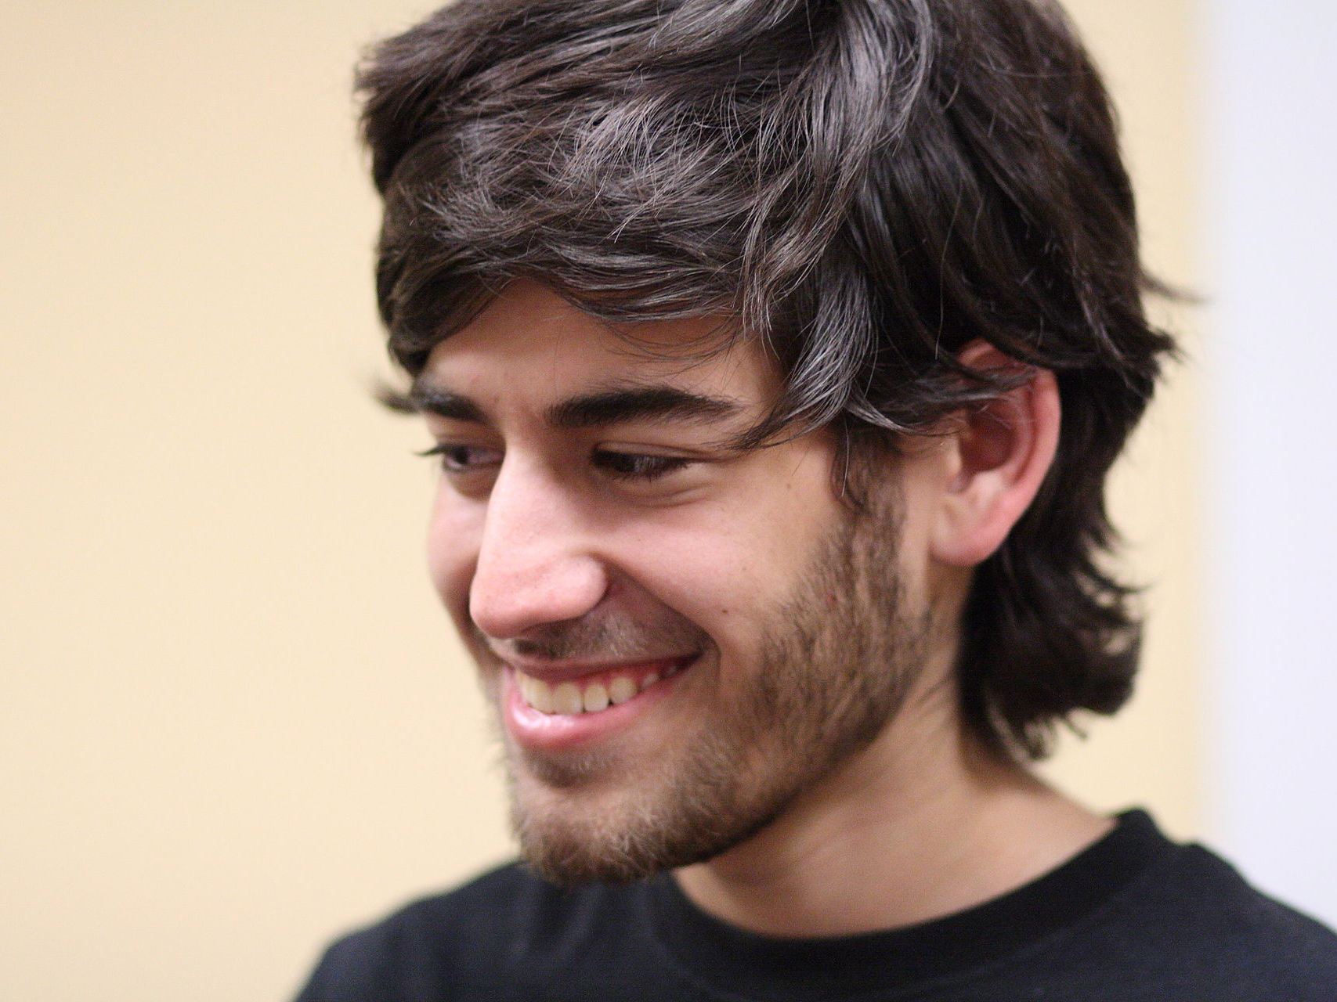

Slide 21
https://www.youtube.com/watch?v=vXr-2hwTk58

